Slide 1
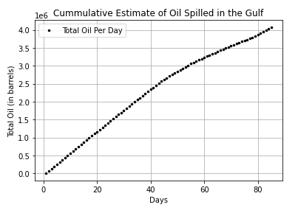

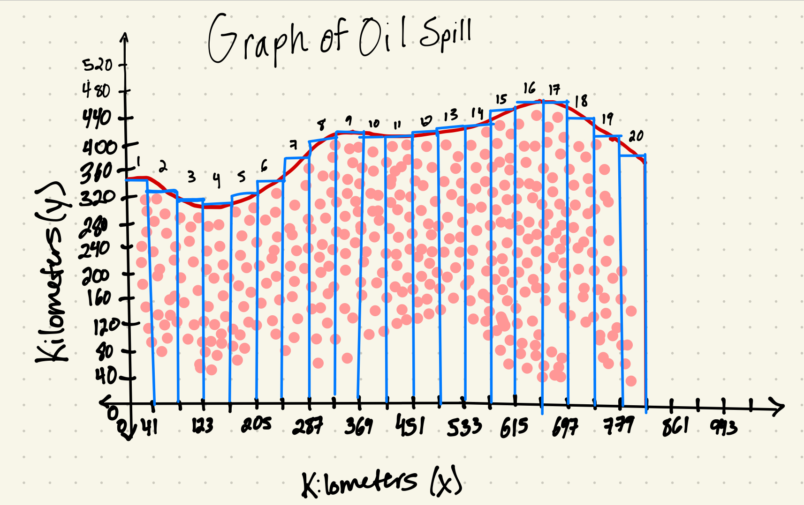
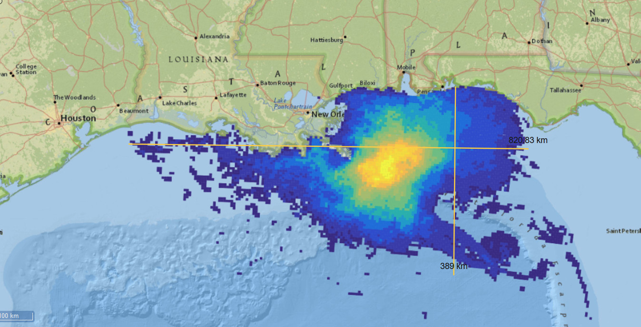
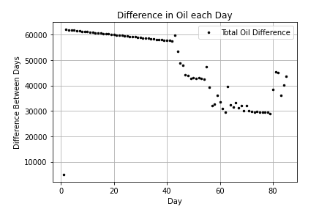
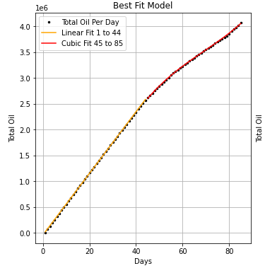
Modeling the 2010 Gulf of Mexico Oil Spill
Alison Abbey, Mylo Fisherman, Karl Muller, Kurt Muller, Zahin Ritee, and Jonah Zgombick
Monica Morales Hernandez, Adelphi University
Introduction
In the spring of 2010, the Deepwater Horizon, an oil rig in the Gulf of Mexico, exploded and sank causing one of the largest oil spills in history.
The research that we plan to carry out is the cleaning up and data collection as a result of the spill. There were different strategies employed to clean up the spill, each with different amounts of success.
In this research, we shall be focusing on cleaning up the oil and collecting data to see the progress. We will have to use calculus in order to do that.
Figure 1: Plotted points of cumulative oil spill data
Approximate Equation for the data and equation from Figure 3 using a piecewise function of both linear and cubic regressions achieved using the python code shown below:
x_1_44 = np.linspace(1,44,440)
linearFormula_1_44 = np.polyfit(df1["Days"][0:44],df1["Total Oil"][0:44],1)
linear_y_1_44 = np.polyval(linearFormula_1_44, x_1_44)
x_45_85 = np.linspace(45,85, 410)
cubicFormula_45_85 = np.polyfit(df1["Days"][44:],df1["Total Oil"][44:],3)
cubic_y_45_85 = np.polyval(cubicFormula_45_85, x_45_85)
Figure 4. Entire breadth of spill and the Riemann sum of the GIS data
Social justice is justice under the conditions of equal rights, equal opportunity, and equal treatment. Within the framework of social justice issues there exists an issue known as environmental justice. Just as social injustices against one’s equal rights occur, environmental injustices can also occur. Environmental injustice is the “disproportionate exposure of certain populations to environmental hazards” (Maantay, 2002).
Social and environmental injustices are vastly interwoven into the aftermath of oil spills, especially one as large as the Deepwater Horizon Oil Spill in 2010. Not only was the spill an environmental disaster, but the spill also didn’t affect everyone equally either.
The government had also approved dumping debris that resulted from the spill near landfills near neighborhoods that were predominatelyblack, Latinx, and Asian.
The combination of environmental injustices and research done by Robert Bullard produced an even further social injustice onto the affected communities: environmental racism.
Figure 2: Difference between each point each day
Problem Formulation
Social Justice
How many barrels of oil were spilled on the surface in the spill?
From the data given on the GIS system provided by the National Oceanic and Atmospheric Administration we were able to determine the volume of oil spilled. The base method of doing this, finding the area, was done by riemann sums.From then on, using the interference of light formula, we were able to determine the thickness of oil in which we multiplied the area by the thickness of oil. This result was the volume of the surface level of oil which was around 131,273 barrels of oil.
What does this result suggest? This places into perspective just the massive devastation that this spill caused.
This was not without its issues. There were things we could’ve done differently, like the proper thickness of oil and an infinite amount of sections for the Riemann Sum.
Figure 3: Best fit line model of Figure 1
This code allows you to take the riemann sum of two sets of points which we needed when analyzing the GIS data:
def riemannSum(a, b, n, points):
sum = 0
deltaX =(b-a)/n
for i in range(n):
sum += points[i][1] * deltaX
return sum
sumFx = riemannSum(0, 820, 20, points1)
sumGx = riemannSum(0, 820, 20, points2)
TotalSum = sumFx - sumGx
print(TotalSum)

